Slide 1


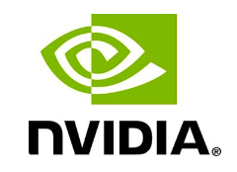
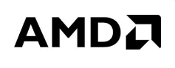
Stock Market Analysis for NVDA, META, AMD, & AI
Team Members: Beza Abebe, Clarice Murhandikire, Kiwaski Nix, Kopano Majara, Francoise Elis Mbazoa Okala, Bridget Ziorklui.

Slide 2
Project Description/outline
Our project aims to analyze the historical performance of AI stocks from NVIDIA (NVDA), Meta Platforms (META), C3.ai (AI), and Advanced Micro Devices, Inc. (AMD). We will use historical price data of these stocks to determine stock prices, rates of return, moving averages, correlations, and the measure of risk related to these stocks.
The presentation will focus on the following areas and questions:
Statistical measures
What is the change in stock prices over the period of ten years?
What trends and patterns do these stocks have in common?
What is the annual rate of return of each stock?
Comparative analysis
What is the moving average (determine specific averages) of the various stocks.
What is the correlation between the daily returns of the stocks?
Measure of Risk
What is the risk associated (as measured by the beta and drawdown of each stock) with investing in these stocks.

Slide 3
Statistical Measures
In this section, we discuss the statistical measures and statistical summary of the the four stocks

Slide 4
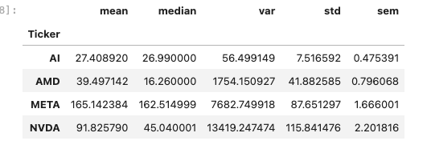
Statistical Measures
This statistical analysis shows the performance of NVDA, META,AMD and AI over a period of ten years
The mean shows the average closing price of each stock .Based on 252 trading days, these values give useful comparisons of the stock prices over time.
The median of all the stocks shown above shows the central tendency of all the stocks and these values or prices will remain centered as a typical market price.
The standard deviation above for each stock shows the variation of the stock prices from the mean stock price. From our data, NVDA has high price fluctuations.
The standard error of the stocks above indicates that the stock price of NVDA is quite unstable since it is a bit far from the mean
The variance shown above shows how risky these stocks are. For a risk averse individual, NVDA is not the best option since it shows evidence of unpredictability.

Slide 5
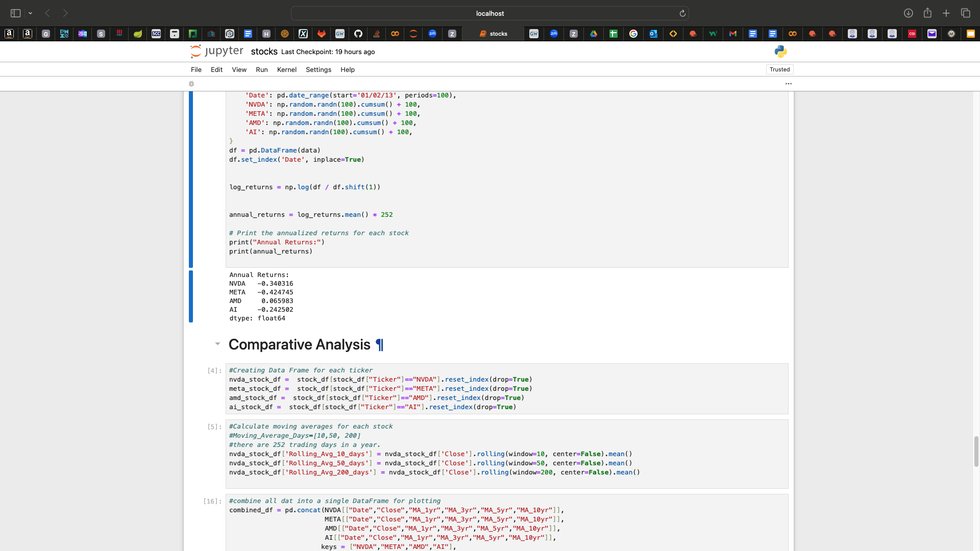
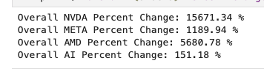
Percent Change and Return of Return
Based on the analysis above AMD had the highest annual rate of return and META the lowest. Over the period of ten years, NVDA has had the highest return and AI the lowest. This is also based on the fact that AI has been on the market for only a year.

Slide 6
Comparative Analysis
In this section , we will elaborate on the AI stocks chosen for this analysis by analyzing the graphing of their calculated moving averages, percentage rate of return and correlation matrix.
Notes:
COMPARATIVE ANALYSIS

Slide 7
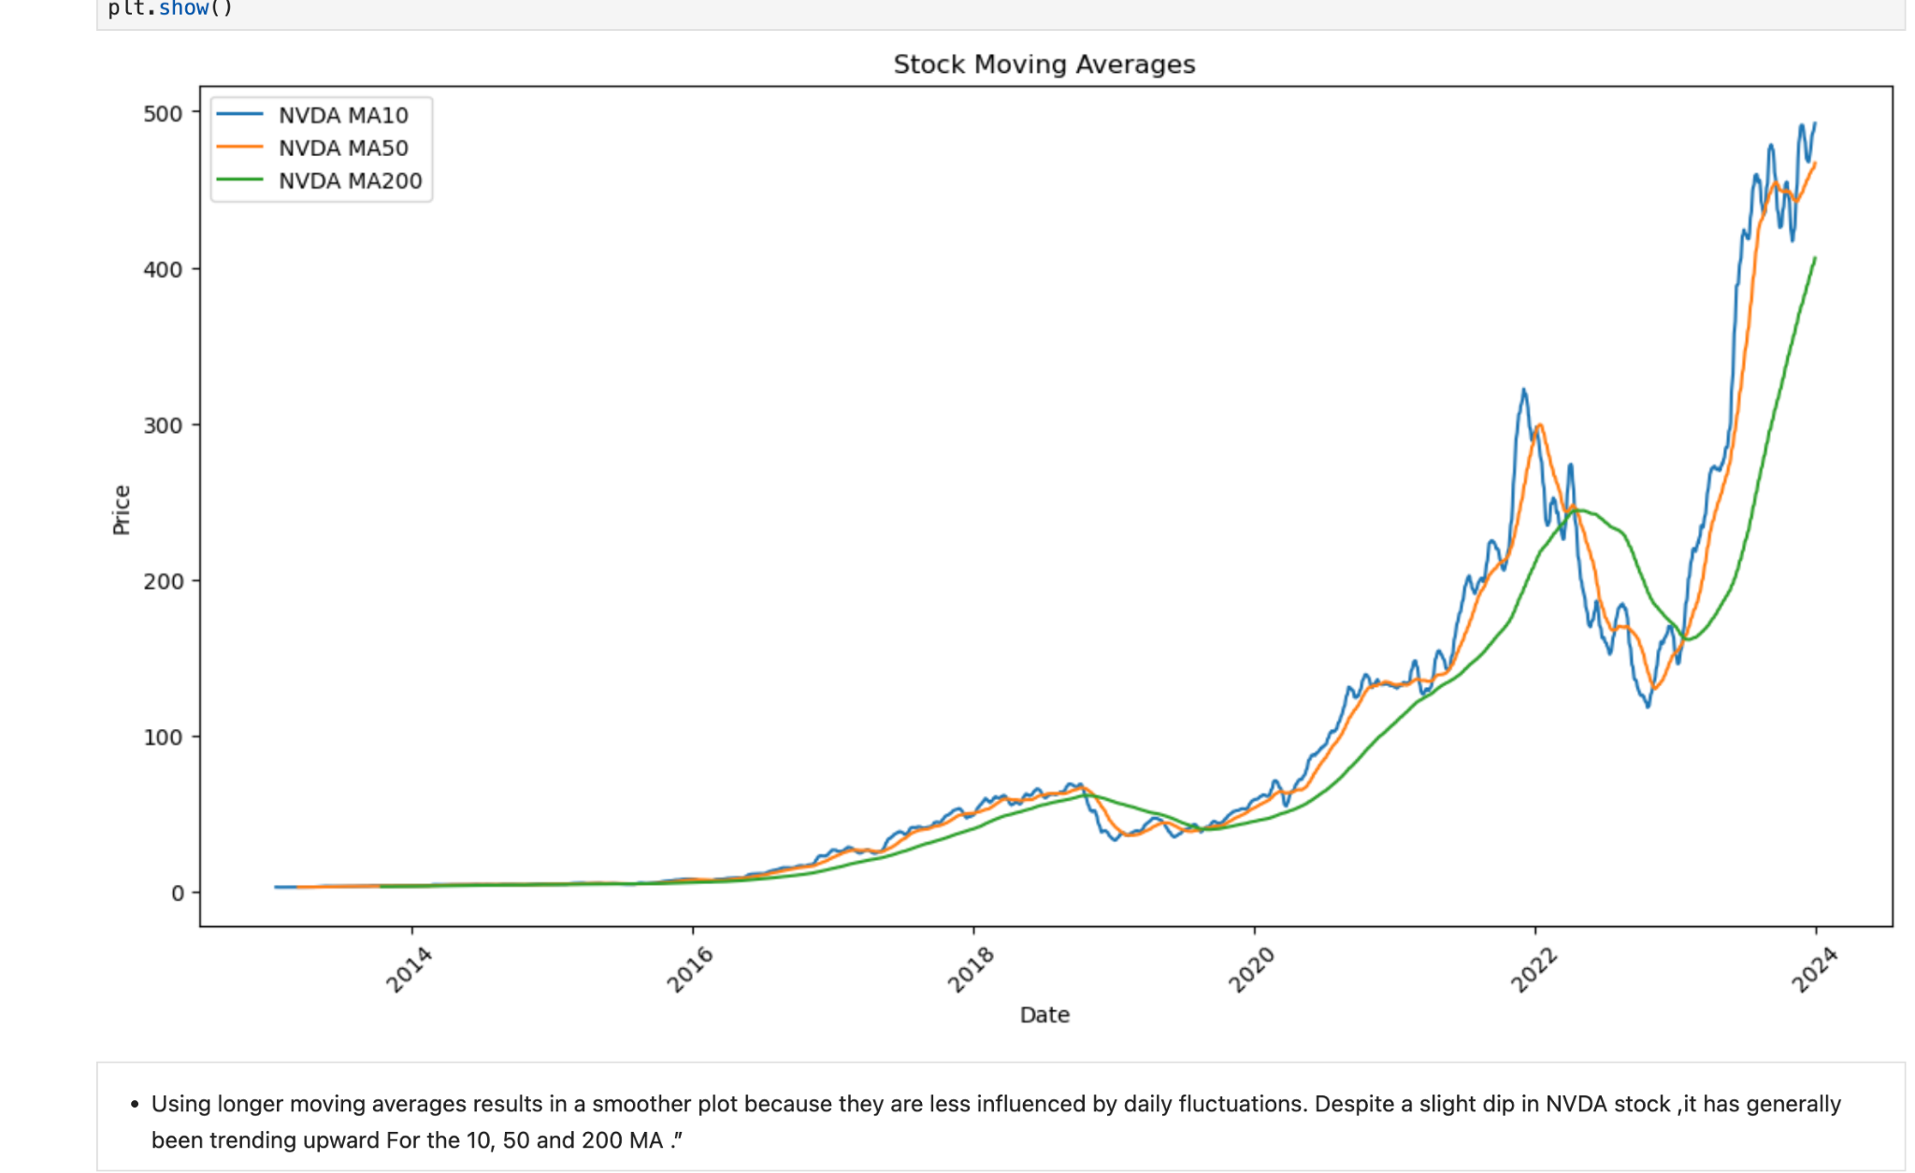
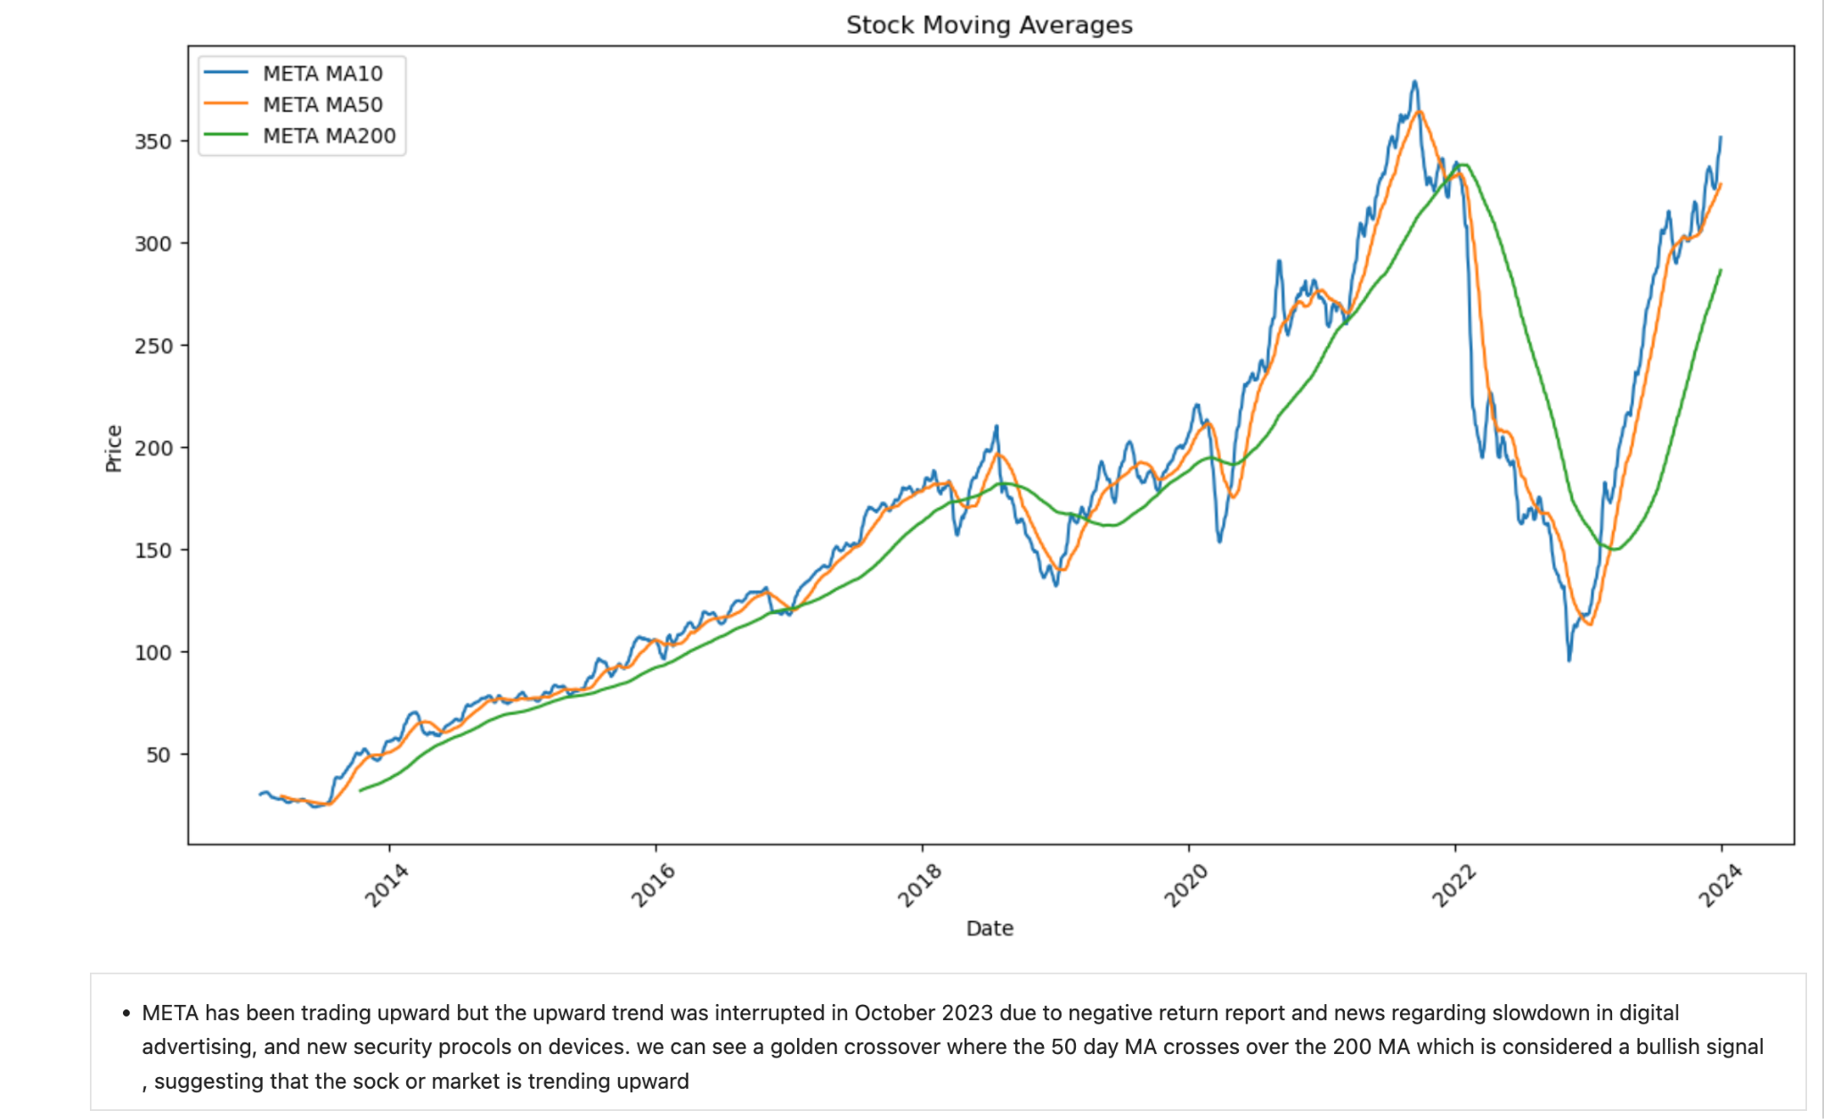
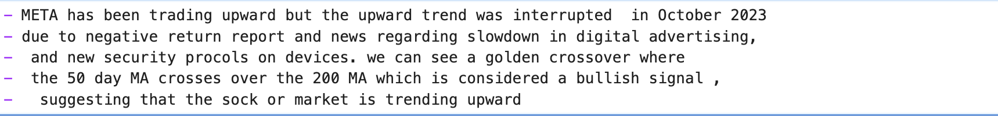
Moving Average - NVDA and META

Slide 8
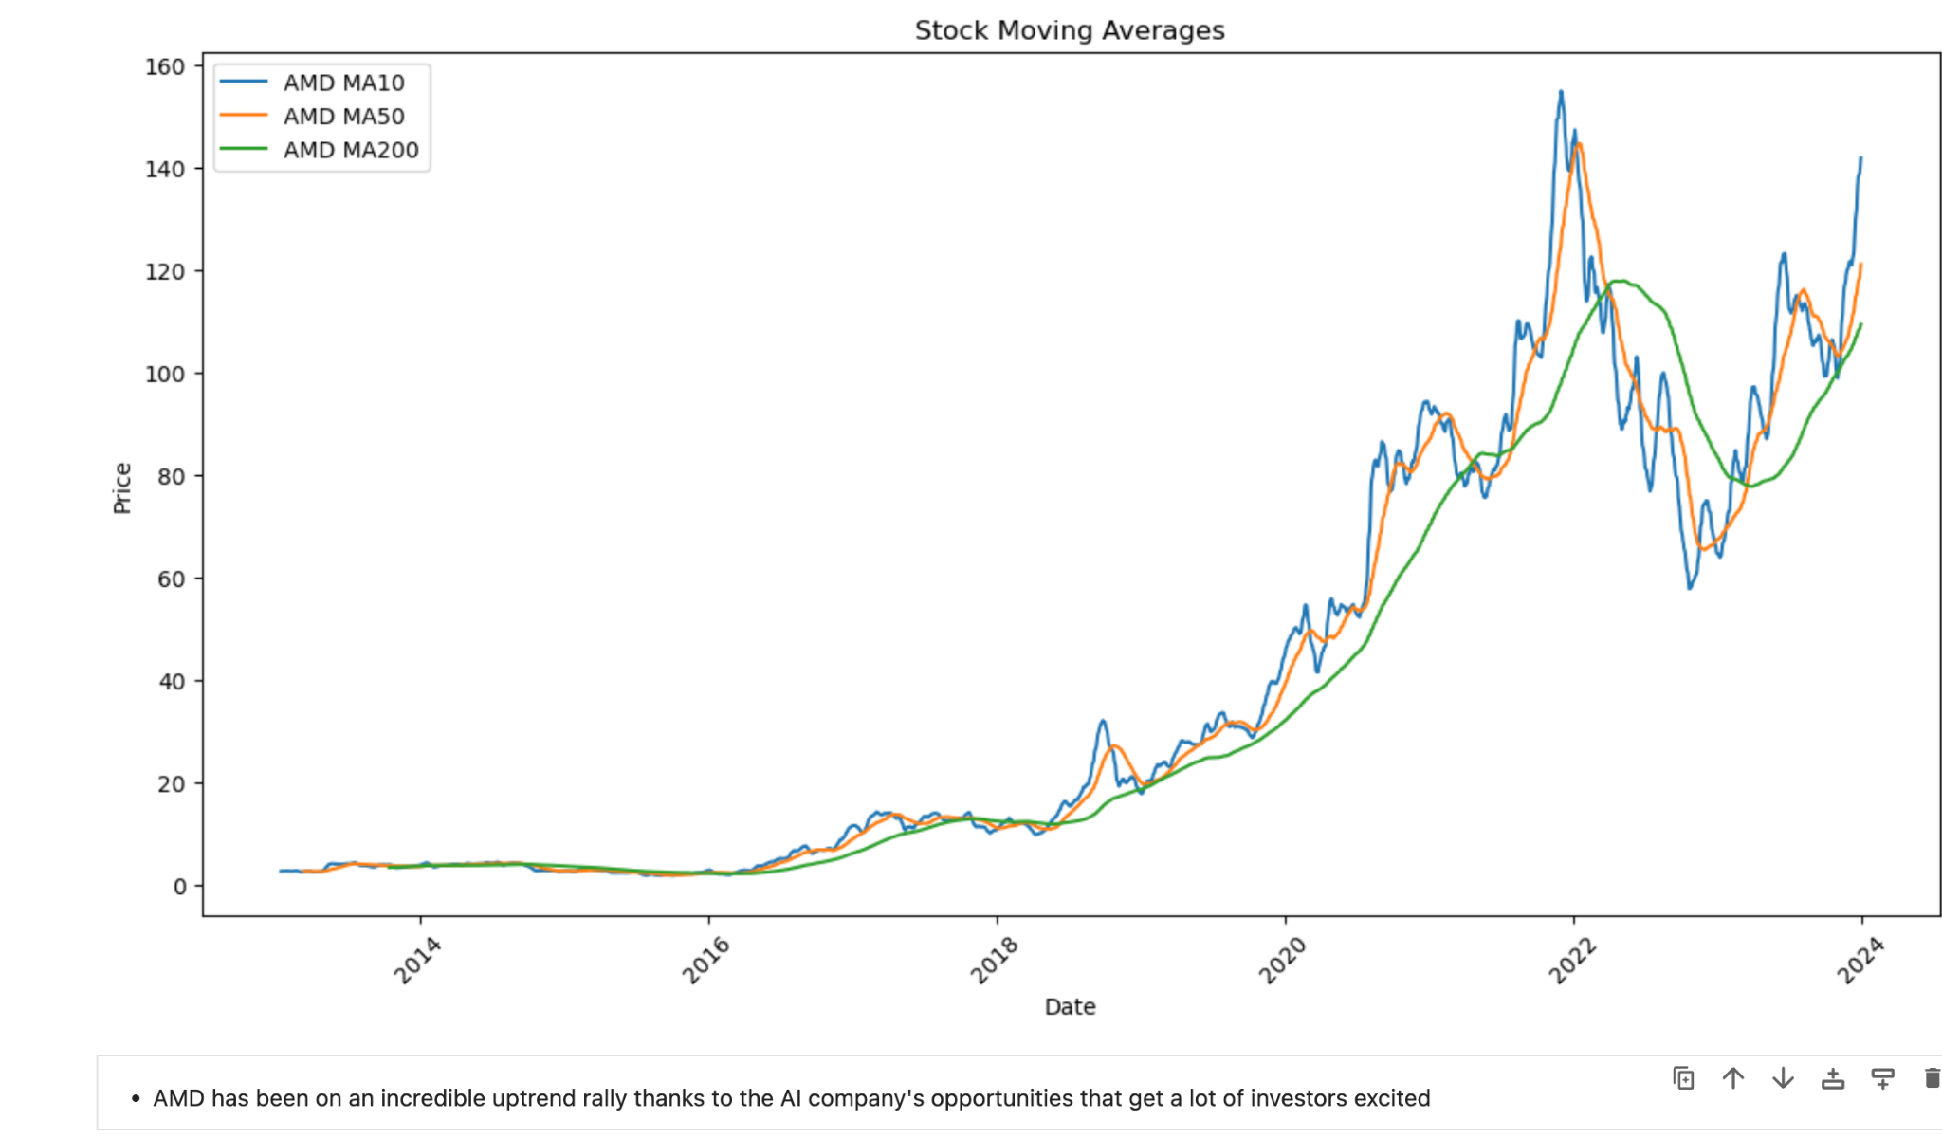
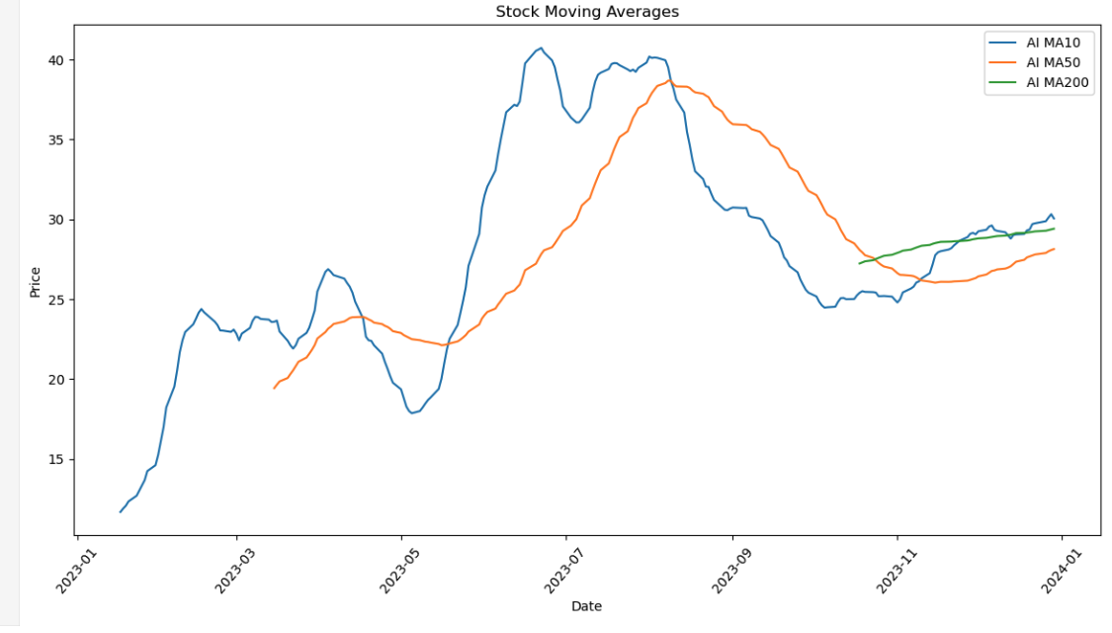
Moving Average - AMD and AI

Slide 9
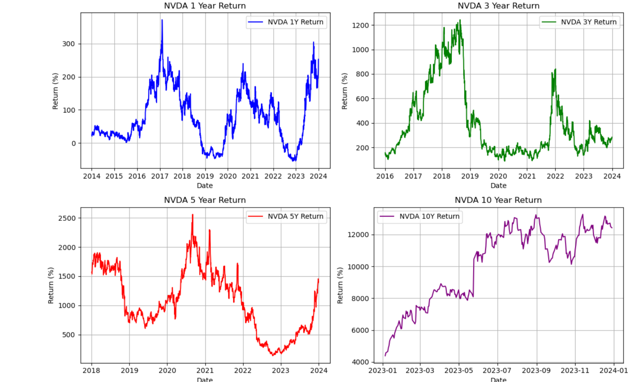
Percentage rate of return
-NVDA return from year 1 and year 10 has increased significantly over the years
-The total return for NVDA over 5 years is about 1,707.03% which means if you invested $100 in NVDA stock 5 years ago, it be worth at least $1800 today if you reinvested dividend and capital gain back into the fund

Slide 10
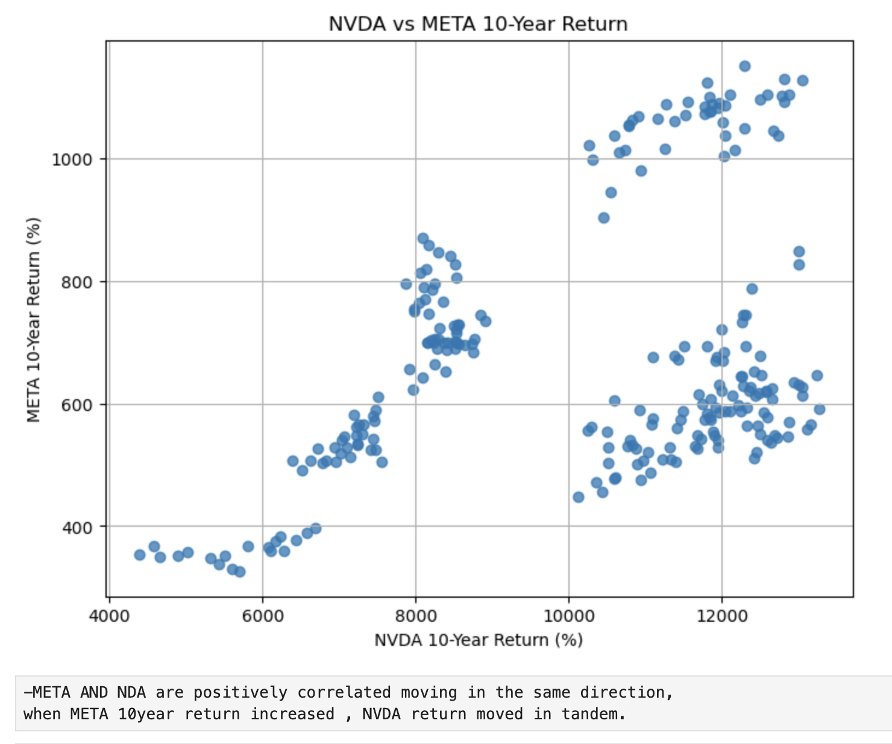
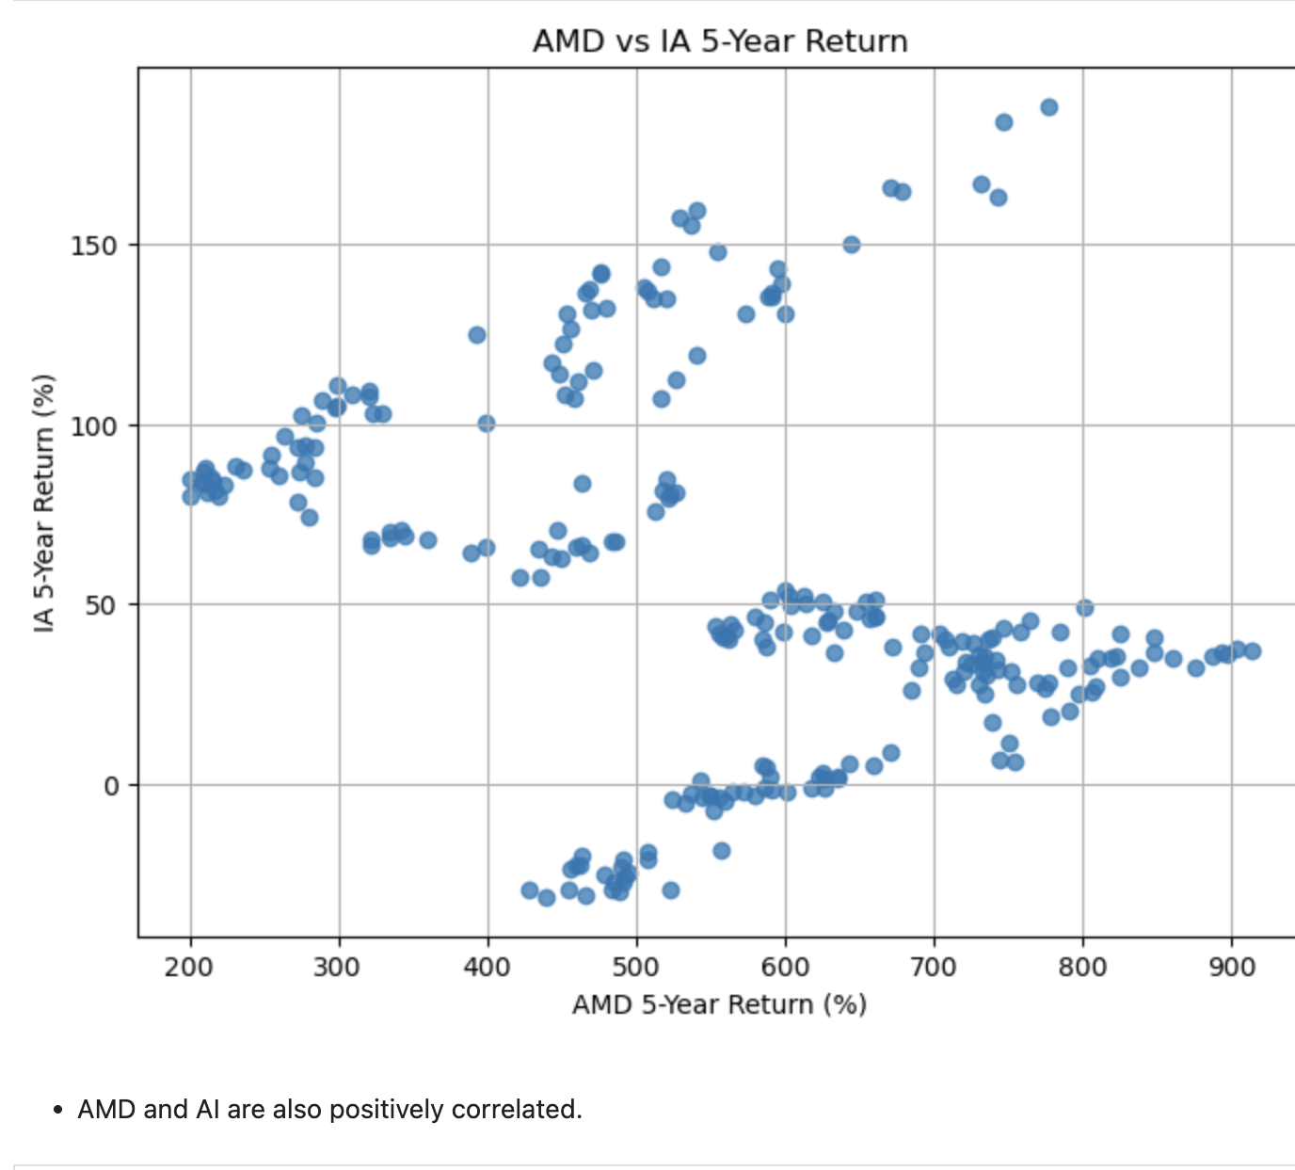
Notes:
The percentage

Slide 11
Measure of Risk
In this section, we will discuss the measure of risk related to the the selected stocks.

Slide 12
Measure of Risk - Beta and Drawdown
BETA is one of the approaches for measuring risk of a stock. Beta calculates the volatility of the stock compared with the overall market’s volatility. The market has a volatility of 1 and all stocks are measured relative to that.
Beta > 1: Stocks are more volatile than the market. These stocks will generally go up more than the market and go down more than the market
Beta < 1: Stocks are less volatile than the market. These stocks move less than the market but they move in the same direction.
Beta < 0: Stocks with negative beta will move inversely to the market.
Drawdown is the change between the peak (highest price) and trough (lowest price) of an investment. Drawdown values are used to measure the financial risk inherent in an investment, specifically, they are a measure of the downward volatility of an investment.
It is expressed as the difference between the highest, the peak value of that stock, and the lowest, the trough value of the stock.
Calculating the drawdown of a stock helps identify the risk associated with the particular investment in that stock.

Slide 13
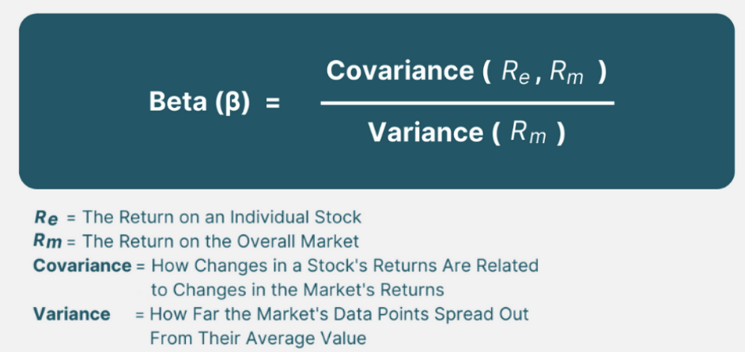
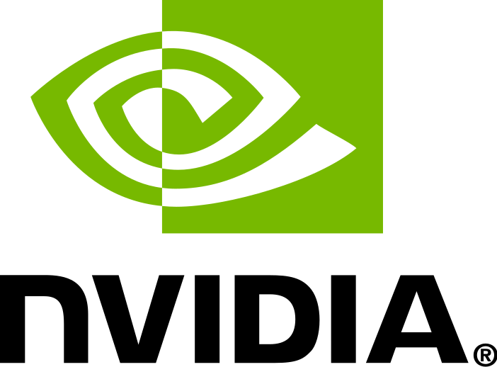
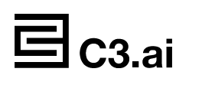
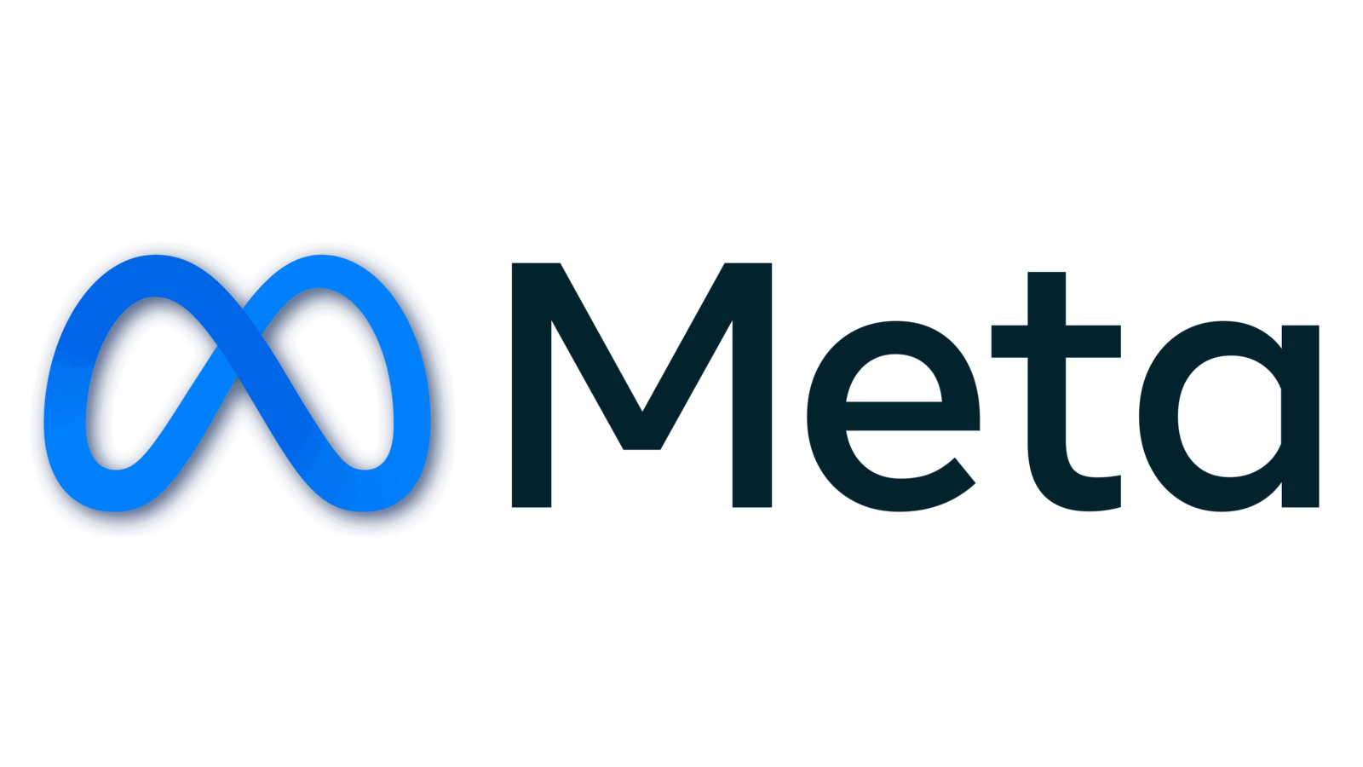

Measure of Risk - Beta Results
The following results were calculated using a Beta formula.
In all 4 cases, the Beta was greater than 1, which implies a high risk and high reward for investing in these stocks.
These stocks will therefore move more than the market in either direction.
Β = 4.11
Β = 2.17
Β = 2.04
Β = 1.76

Slide 14
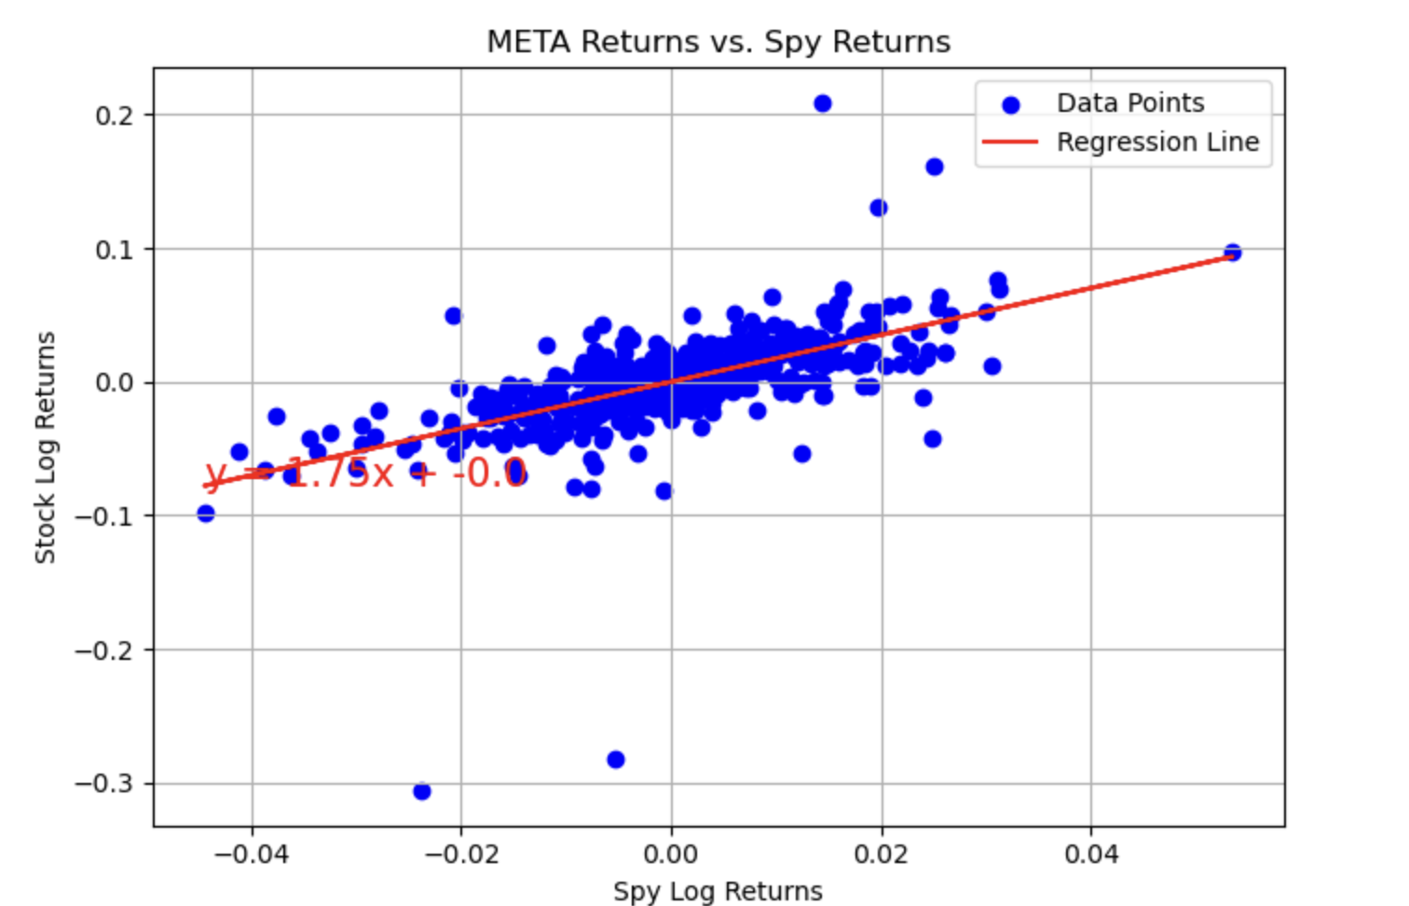
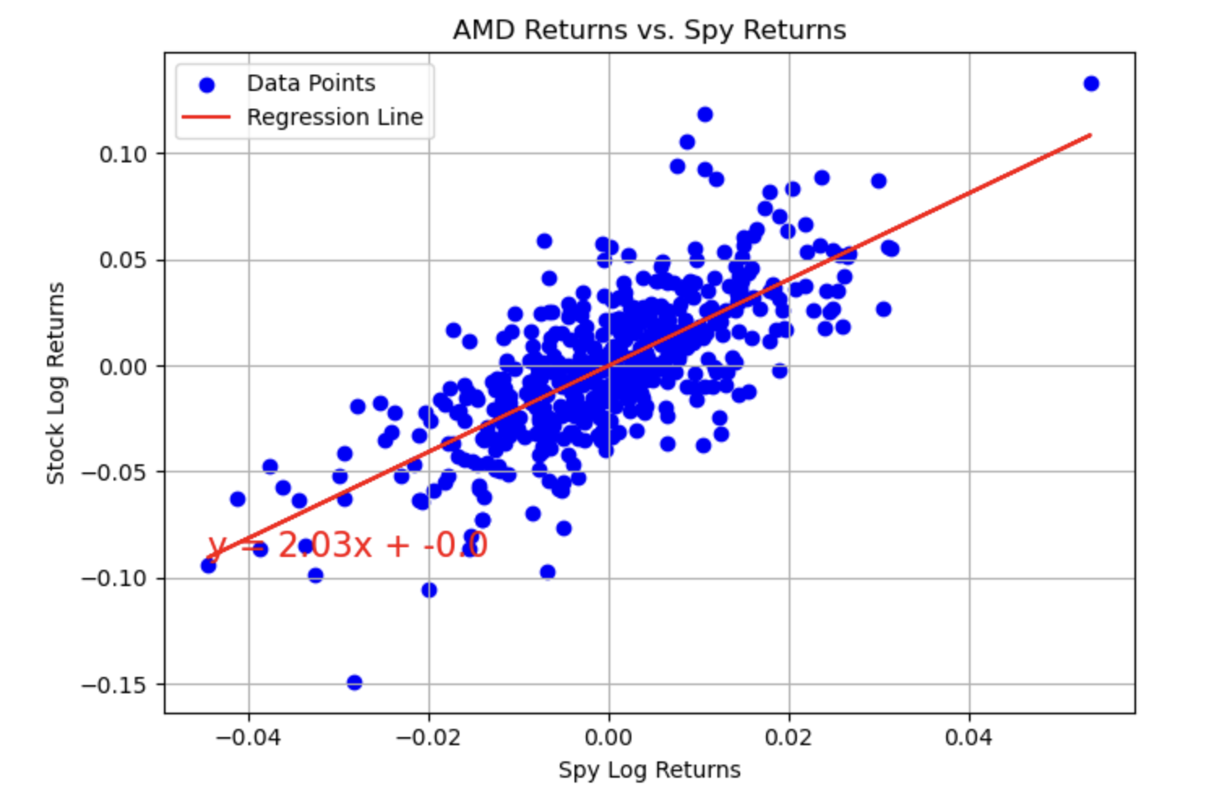
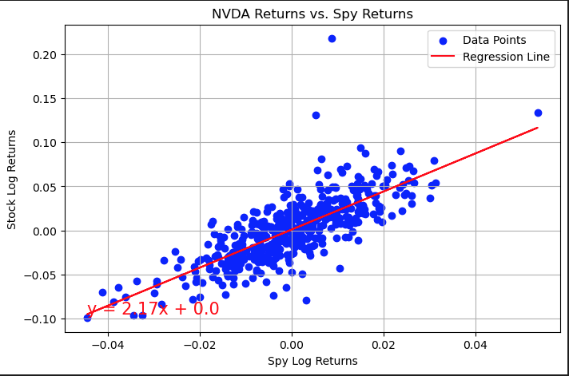
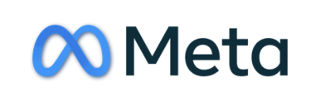
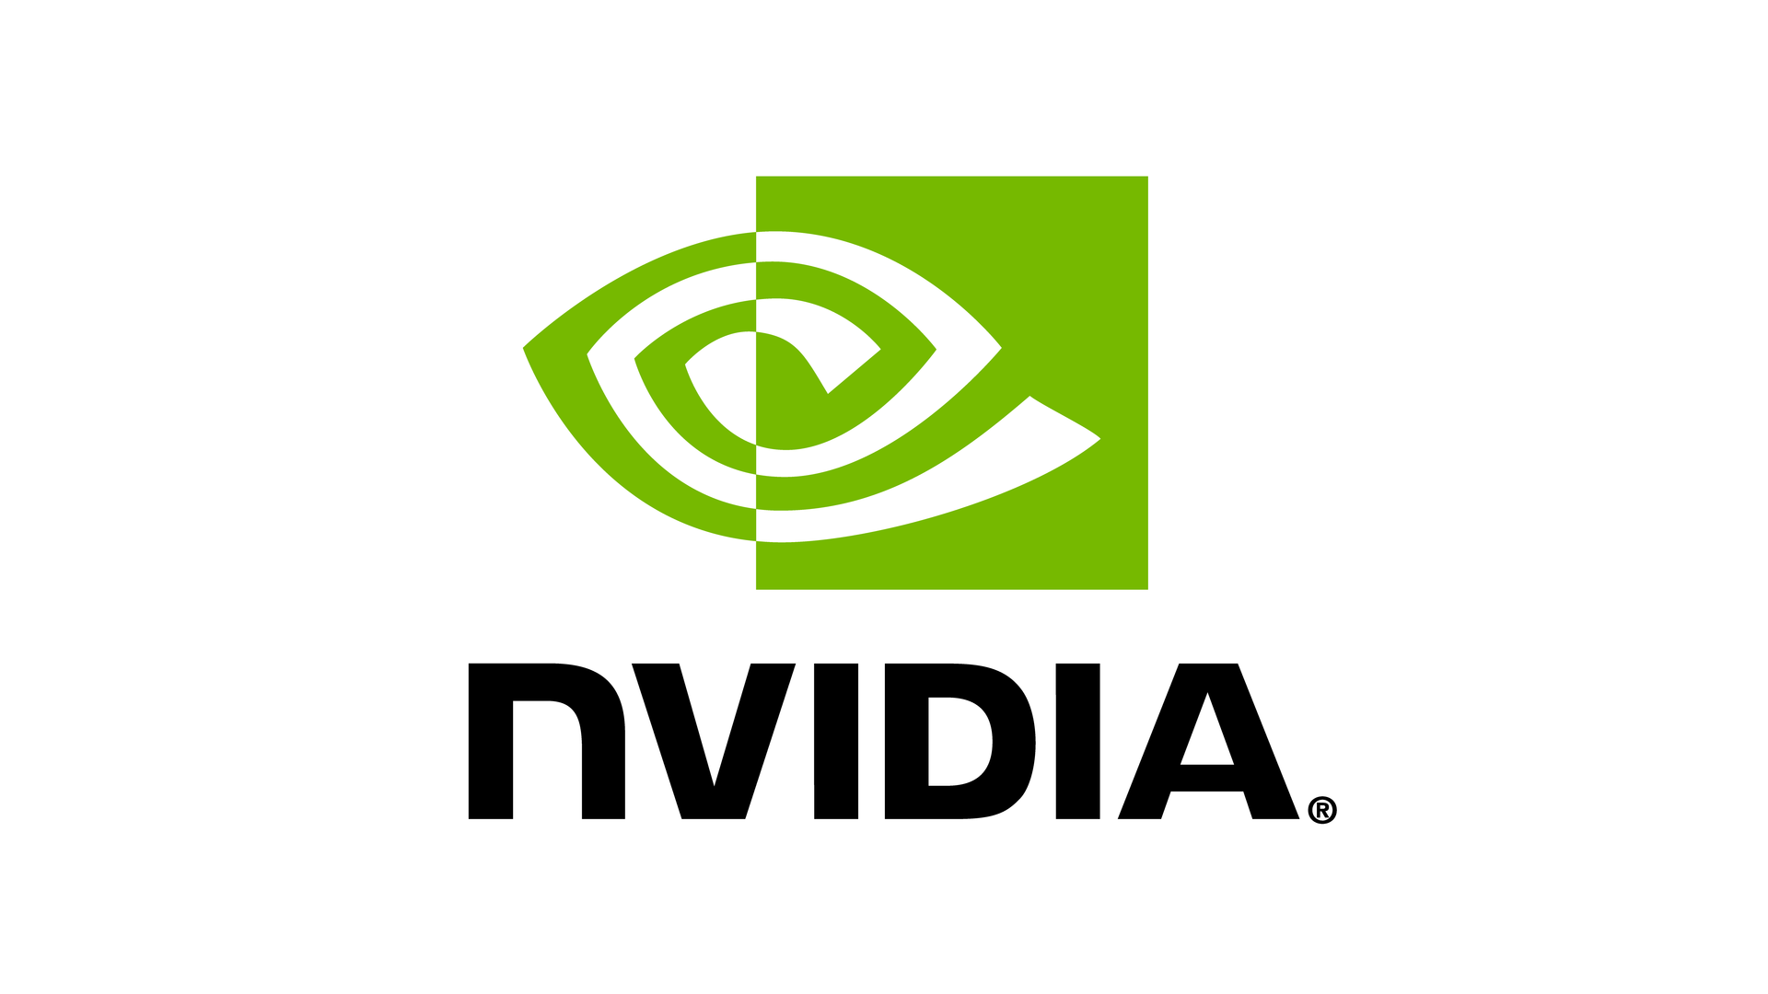
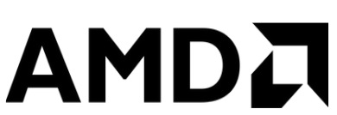
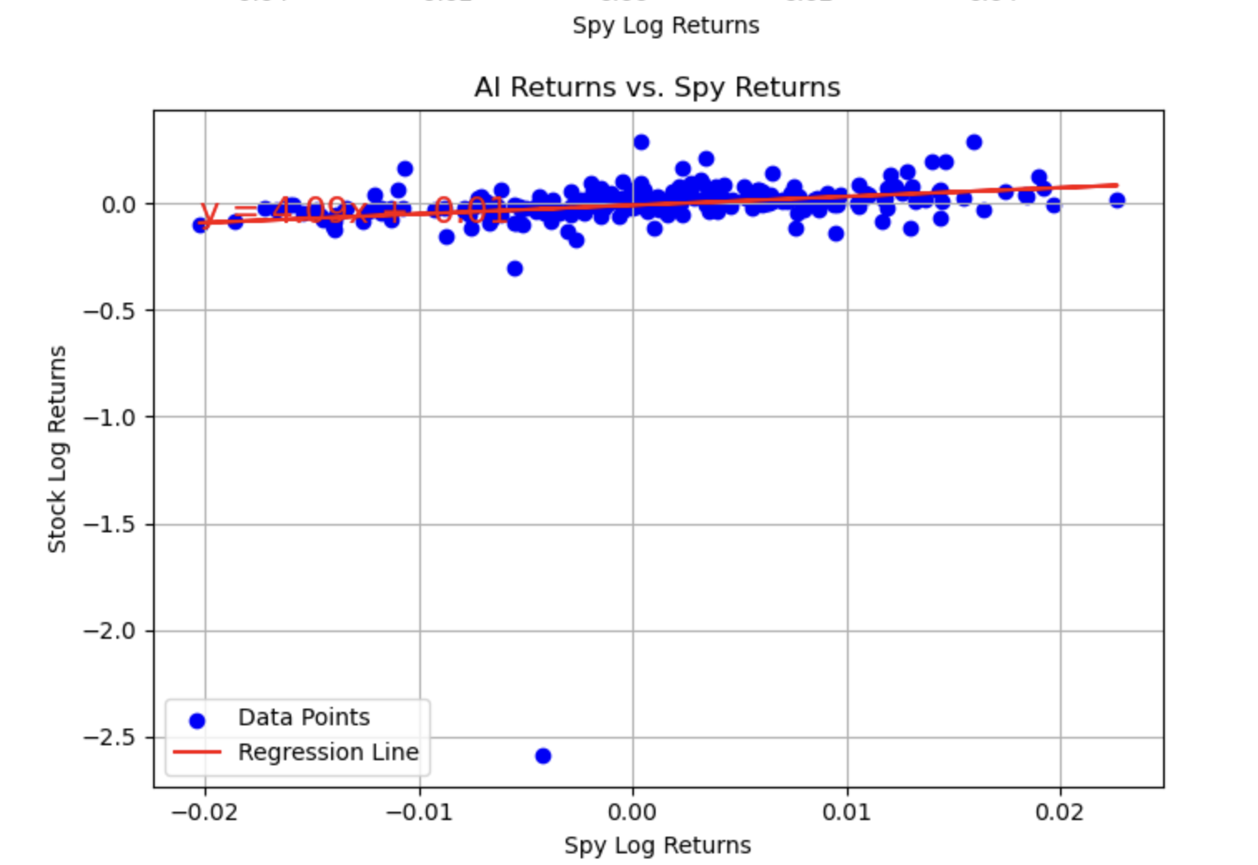
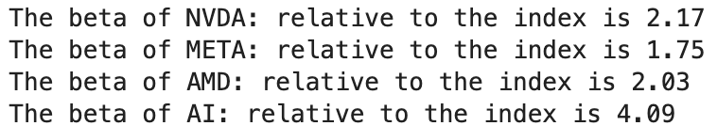
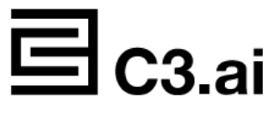
Measure of Risk - Beta Results
Beta can also be calculated via regression analysis, where the slope of the regression line for stock return data vs market return data represents the beta.
Each of the stocks' returns resulted in a beta that is greater than 1. This signifies that the volatility of the prices exceeds that of the market. Small cap and technology stocks typically have higher betas than the market benchmark. Therefore, adding stocks to a portfolio will raise its risk, but it may also improve its expected return.

Slide 15
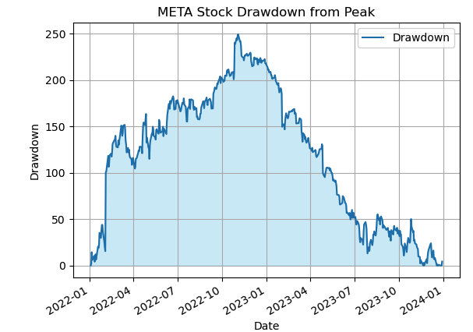
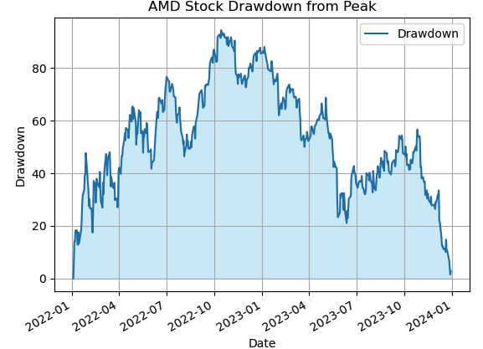
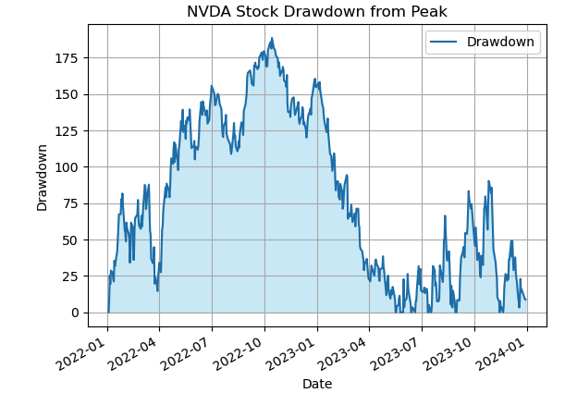
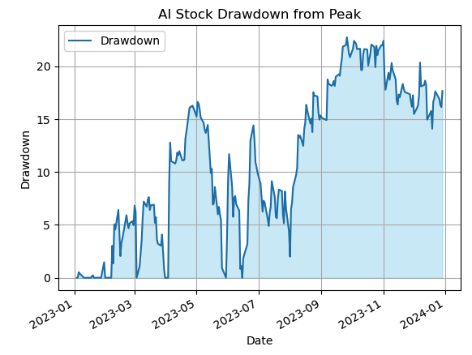
Measure of Risk - Drawdown Results
META stock drawdown graph indicates that there has been a pretty steep and steady decline over time.
This suggests that it might be riskier to invest at this time.
The AMD Stock has had a rollercoaster year, with a sharp drop from its highest point, making it very unpredictable.
The AMD Stock is risky to invest in at this time.
The NVDA stock graph is showing the ups and downs of the stock for the past year. After reaching its peak, it has continued to drop.
This suggests that the stock is very volatile, and it is risky to invest in at this time.
The AI stock has had its up and downs when it comes to drawdowsm, but not too drastic.
In terms of risks, the AI stock is somewhat steady and not too risky to invest in at this moment.
Based on the finding of the graphs, META is dropping a lot, which indicates it is risky to invest in. NVDA goes up and down a lot,which makes it very unpredictable.
AMD has some ups and downs as well but it is not as unpredictable as NVDA. However, AI stock is more stable and no significant changes has occurred yet.

Slide 16
Conclusion
NVDA displays high volatility with substantial price fluctuations, indicated by its high standard deviation and variance, making it less suitable for risk-averse investors. In contrast, AI stocks show more stability with minimal significant changes.
META's significant drawdowns suggest high investment risk, whereas NVDA's unpredictable price movements emphasize its instability. AMD shows moderate volatility, which is less than NVDA but more than AI stocks.
Despite past performances, AMD, AI, META, and NVDA all exhibit a positive correlation and an upward trend in returns over 1, 3, 5, and 10 years, highlighting potential growth opportunities in AI investments as the market has not yet peaked.

Slide 17
Thank You

